Slide 1
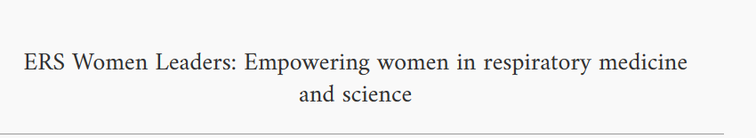
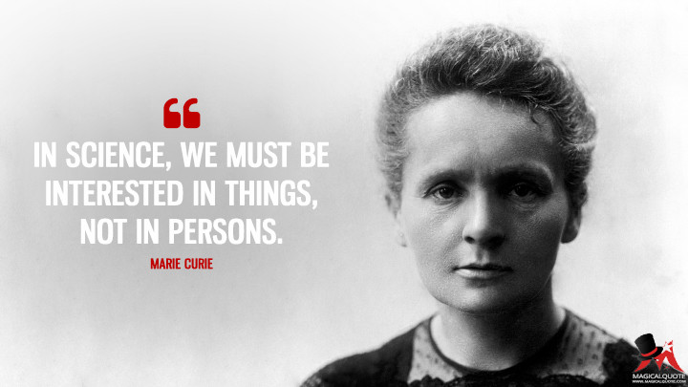
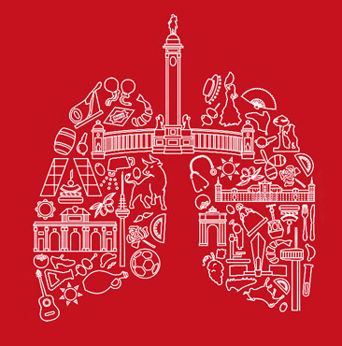
Dr. Sabine Bartel
ERS/EU Marie Sklodowska-Curie RESPIRE3 Fellow

Slide 2
Conflict of interests Dr. Sabine Bartel
X I have no real or perceived conflicts of interest that relate to this presentation.
I have the following real or perceived conflicts of interest that relate to this presentation:
Affiliation / Financial interest | Commercial Company
Grants/research support: | Bencard Allergie GmbH (unrestricted grant for research)
Honoraria or consultation fees: | Bencard Allergie GmbH
Participation in a company sponsored bureau:
Stock shareholder:
Spouse / partner:
Other support / potential conflict of interest:
This event is accredited for CME credits by EBAP and EACCME and speakers are required to disclose their potential conflict of interest. The intent of this disclosure is not to prevent a speaker with a conflict of interest (any significant financial relationship a speaker has with manufacturers or providers of any commercial products or services relevant to the talk) from making a presentation, but rather to provide listeners with information on which they can make their own judgments. It remains for audience members to determine whether the speaker’s interests, or relationships may influence the presentation. The ERS does not view the existence of these interests or commitments as necessarily implying bias or decreasing the value of the speaker’s presentation. Drug or device advertisement is forbidden.

Slide 3
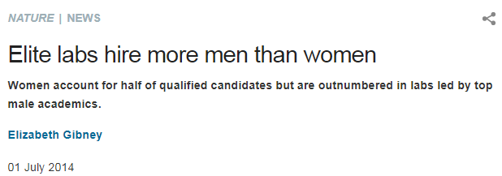

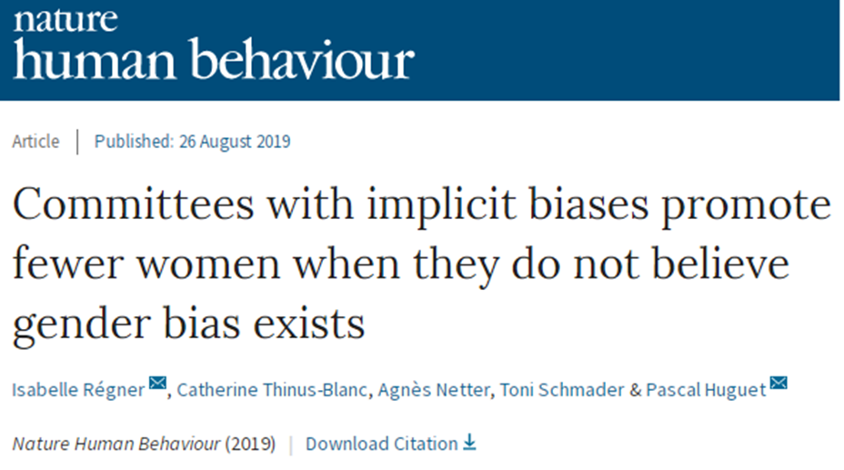
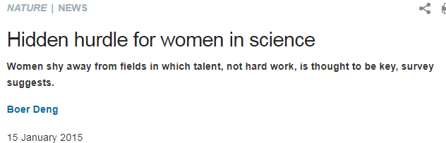
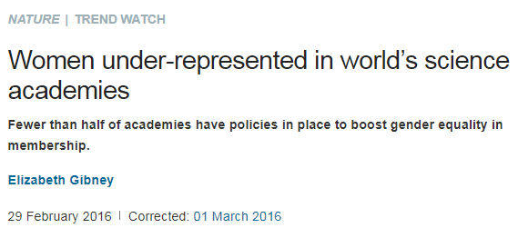
Women in Science?

Slide 4

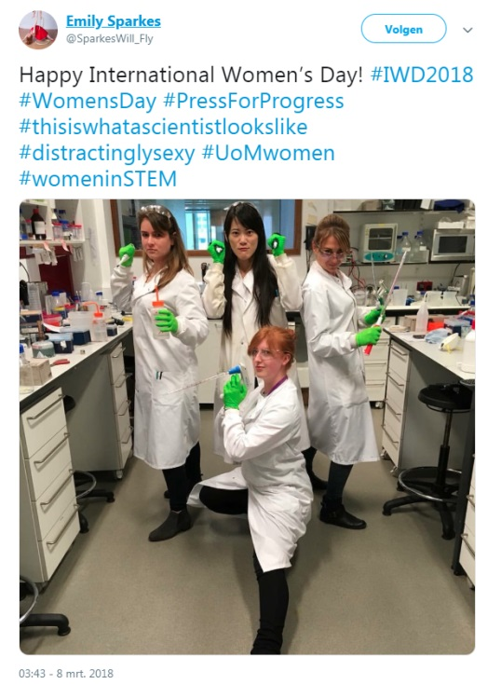
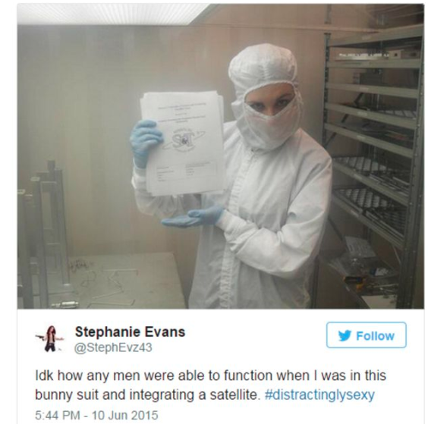
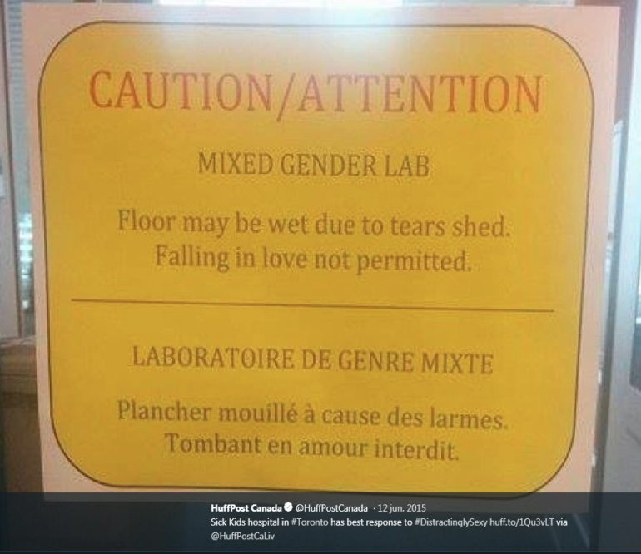
Credibility of women in science
Tim Hunt: “Three things happen when women are in the lab: you fall in love with them, they fall in love with you, and when you criticise them they cry."
#distractingly sexy

Slide 5

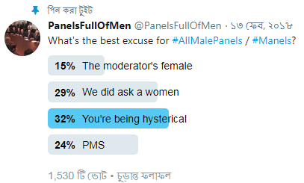

Credibility of women in science
#manels
Manel = male-only panel
Manferences = male-dominated conferences

Slide 6
Credibility of women in science
There are other approaches within feminism that recognise that part of what’s happened is not so much a backlash, but the sense that there is a price to pay for the gains that we make, and continue to make, and it’s there in the sense of an increasingly visible and tangible pressure on women, especially young women, to have it all, to be it all and work hard, play hard and measure up in all the metrics
https://www.sciencefocus.com/science/is-the-effort-to-get-more-women-in-stem-worth-it/

Slide 7
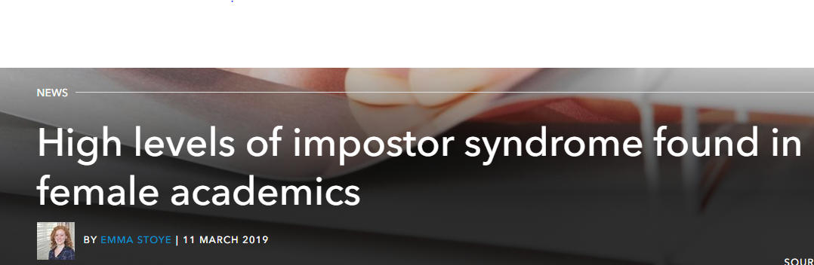
Credibility of women in science
Impostor syndrome, a condition characterised by feelings of self-doubt, incompetence and a lack of belonging.
"These women do not experience an internal sense of success"
A R Vaughn, G Taasoobshirazi and M L Johnson, Studies in Higher Education, 2019, DOI: 10.1080/03075079.2019.1568976
https://www.chemistryworld.com/news/high-levels-of-impostor-syndrome-found-in-female-academics/3010214.article
https://www.sciencemag.org/careers/2008/02/no-youre-not-impostor

Slide 8
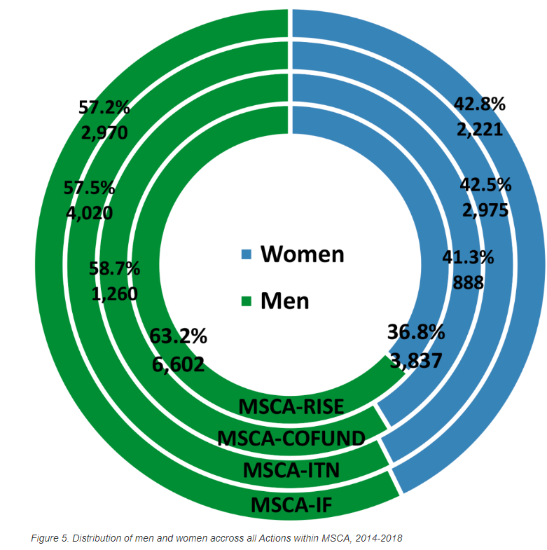
Funding for Research
Marie Sklodowska-Curie Actions
https://euraxess.ec.europa.eu/worldwide/japan/gender-equality-policies-and-gender-distribution-msca-and-erc

Slide 9
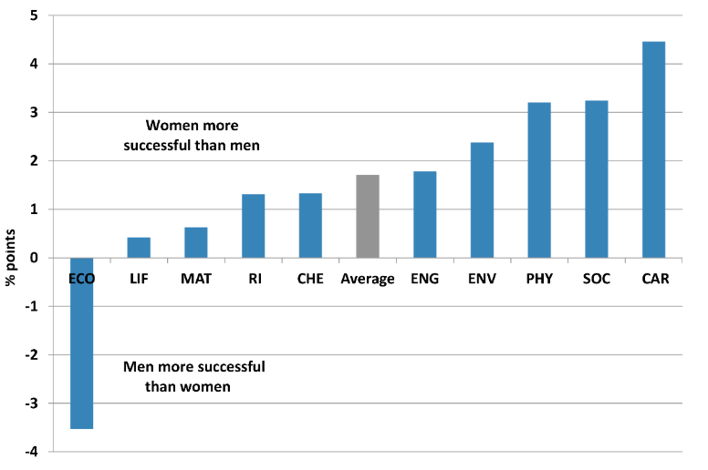
Funding for Research
Marie Sklodowska-Curie Individual Fellowships
https://euraxess.ec.europa.eu/worldwide/japan/gender-equality-policies-and-gender-distribution-msca-and-erc

Slide 10
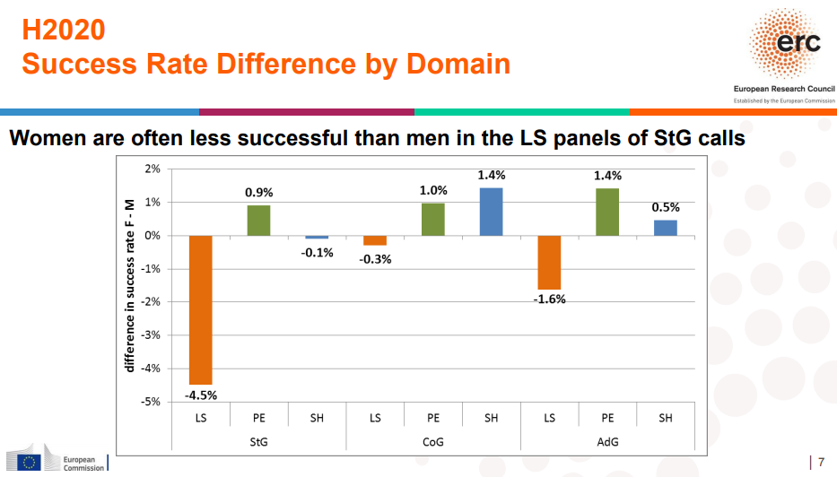
Funding for Research
https://erc.europa.eu/sites/default/files/document/file/Gender_statistics_Apr2018.pdf

Slide 11
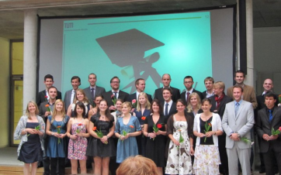

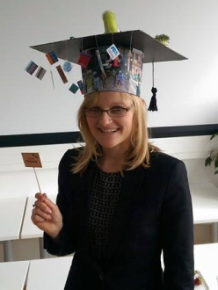

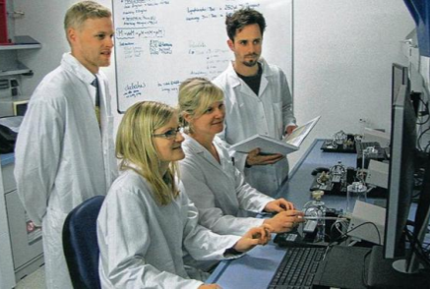

My personal journey
Molecular Biotechnology (B.Sc./M.Sc.)
- Technical University of Munich
PhD in experimental asthma research
– Comprehensive Pneumology Center Munich
Postdoc in early origins of chronic lung disease
- Leibniz Lung Center Borstel, Germany

Slide 12

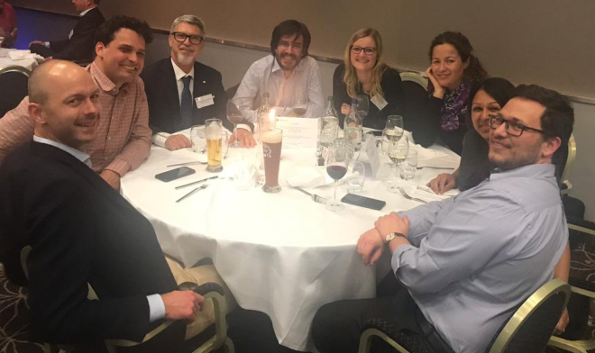
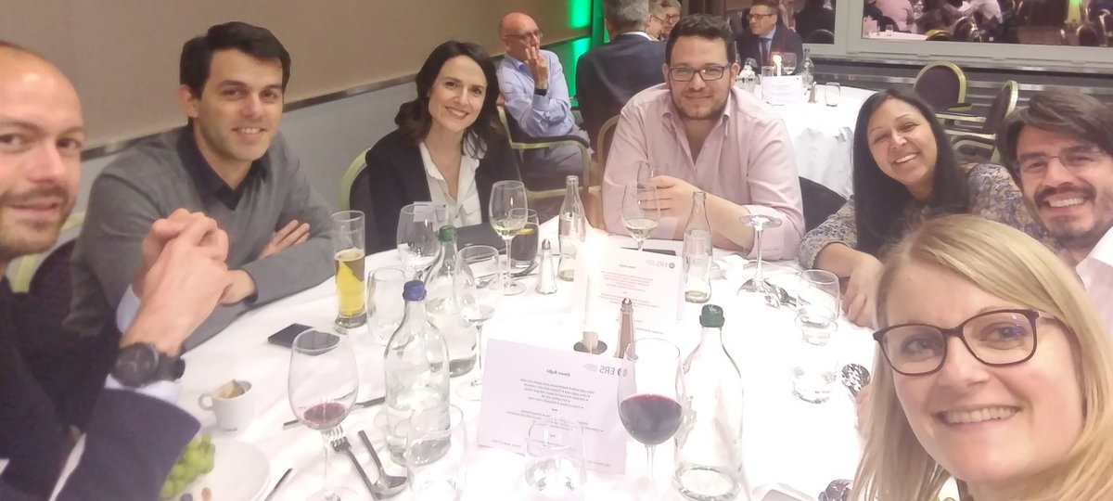
My personal ERS journey
Early Career Representative of Assembly 3 (2016-2019)

Slide 13
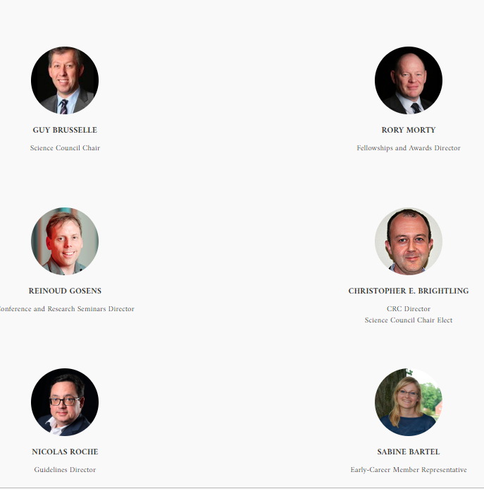
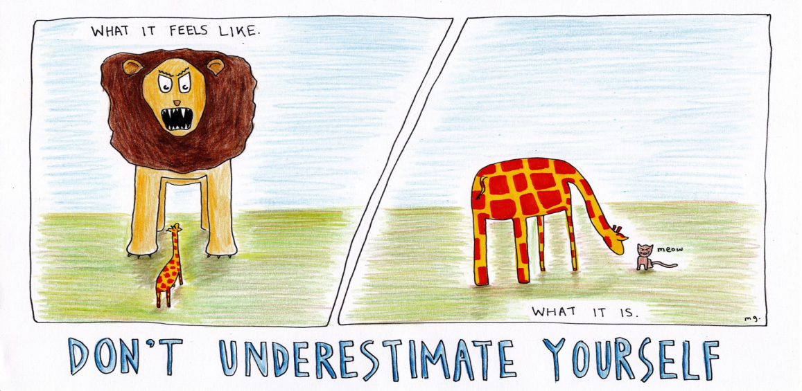

My personal ERS journey
Early Career Member (ECM) Representative of Assembly 3 (2016-2019)
=> ECM representative in the ERS Science Council (2018-2019):
+ 12 male vs 2 female Assembly heads

Slide 14
My personal ERS journey
Secretary of Group 3.2. (Assembly 3) (2019-2022)
Assembly 3 from 2019 | f | m
Head | 1 | 0
Secretary | 1 | 0
Under-40 representative | 1 | 0
Group | f | m
Secretary | 2 | 1
Chair | 3 | 0

Slide 15



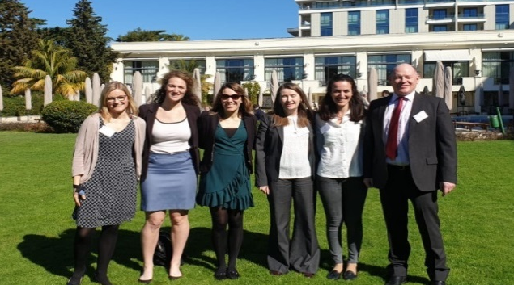
My personal ERS journey
ERS/EU RESPIRE3 Marie Sklodowska-Curie Fellow (2018-2020)
ERS fellowship scheme: (2016-19)
49.3% of all applications received were from female candidates
51% of all selected fellowship recipients were female

Slide 16
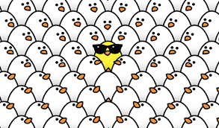
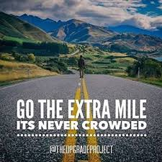
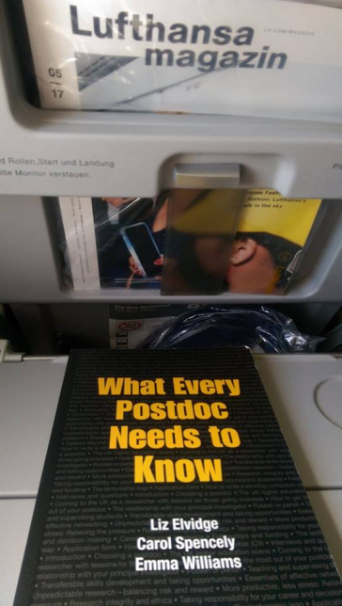
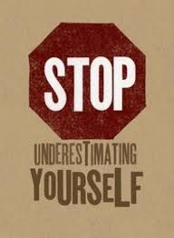
Never stop
learning!
Stand out of the crowd!
Go the extra mile!
Know your worth!
Nothing worth having in this world comes easy!

Slide 17
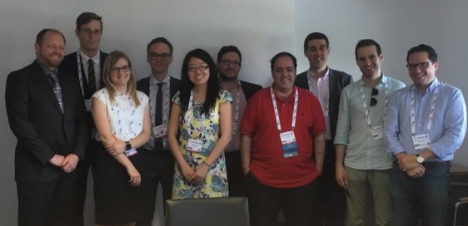
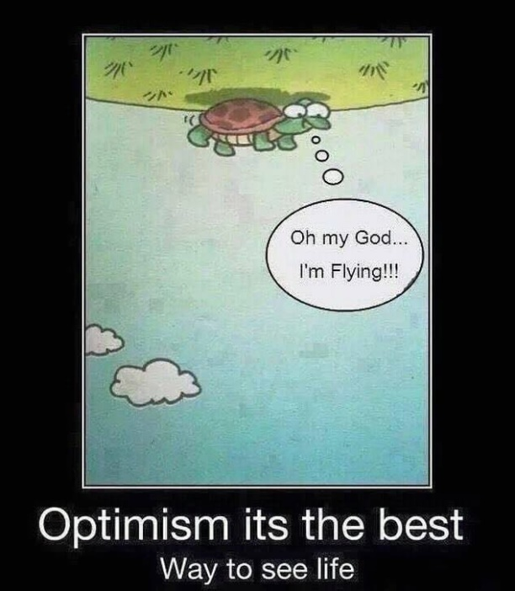
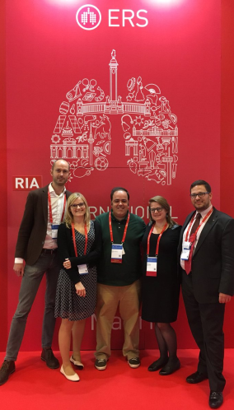
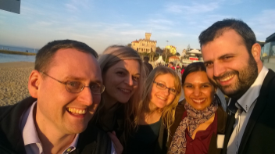
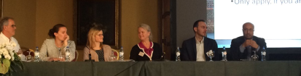
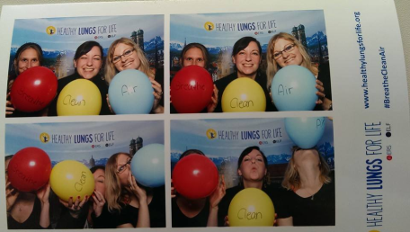
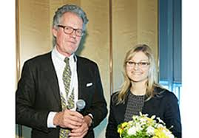
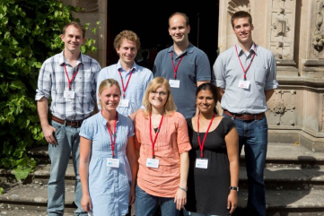
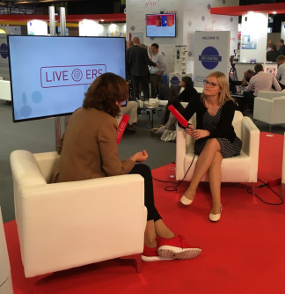
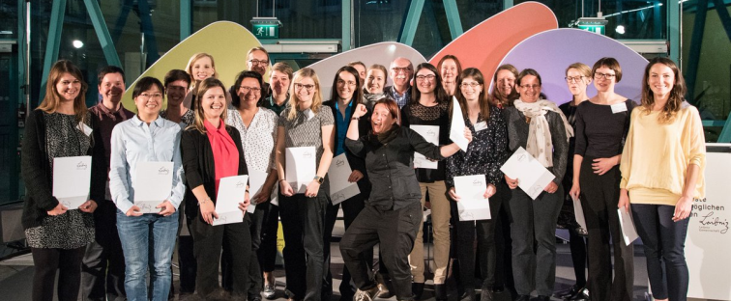
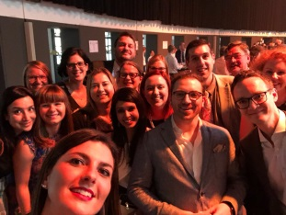
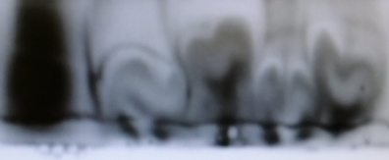
Enjoy what you are doing!
Thank you for your attention
@SabineB86

